Slide 1
4.2
Logical Database Design

Slide 2
Outline
Informal Design Guidelines for Relational Databases
Semantics of the Relation Attributes
Redundant Information in Tuples and Update Anomalies
Null Values in Tuples
Spurious Tuples
Functional Dependencies (FDs)
Definition of Functional Dependency

Slide 3
Informal Design Guidelines
For
Relational Databases

Slide 4
Informal Design Guidelines for Relational Databases
What is relational database design?
The grouping of attributes to form "good" relation schemas
Two levels of relation schemas
The logical "user view" level
The storage "base relation" level
Design is concerned mainly with base relations
What are the criteria for "good" base relations?

Slide 5
Pitfalls of Duplication
ID | Name | Course Code | Course Title | ECTS | Pre_Req
ATR/8932/10 | Yonas Fiseha | ECEG-4191 | Database Systems | 5 | OOP
ATR/9127/10 | Leul Mengistu | ECEG-4191 | Database Systems | 5 | OOP
ATR/0382/10 | Natnael Getachew | ECEG-4191 | Database Systems | 5 | OOP
ATR/5845/10 | Samuel Teshome | ECEG-4191 | Database Systems | 5 | OOP
ATR/8157/10 | Nahom Sileshi | ECEG-4191 | Database Systems | 5 | OOP
Duplication:
Increases size of database
leads to more issues.

Slide 6
Insertion Anomaly
ID | Name | Course Code | Course Title | ECTS | Pre_Req
ATR/8932/10 | Yonas Fiseha | ECEG-4191 | Database Systems | 5 | OOP
ATR/9127/10 | Leul Mengistu | ECEG-4191 | Database Systems | 5 | OOP
ATR/0382/10 | Natnael Getachew | ECEG-4191 | Database Systems | 5 | OOP
ATR/5845/10 | Samuel Teshome | ECEG-4191 | Database Systems | 5 | OOP
ATR/8157/10 | Nahom Sileshi | ECEG-4191 | Database Systems | 5 | OOP
ATR/0000/00 | XX-YY-ZZ | ECEG-4191 | Database Systems | 5 | OOP
Insertion Anomaly Must insert course code, course title, ECTS, Pre-Req.

Slide 7
Deletion Anomaly
ID | Name | Course Code | Course Title | ECTS | Pre_Req
ATR/8932/10 | Yonas Fiseha | ECEG-4191 | Database Systems | 5 | OOP
ATR/9127/10 | Leul Mengistu | ECEG-4191 | Database Systems | 5 | OOP
ATR/0382/10 | Natnael Getachew | ECEG-4191 | Database Systems | 5 | OOP
ATR/5845/10 | Samuel Teshome | ECEG-4191 | Database Systems | 5 | OOP
ATR/8157/10 | Nahom Sileshi | ECEG | OOP | 5 | Int. Comp.
ATR/0000/00 | XX-YY-ZZ | ECEG-4191 | Database Systems | 5 | OOP
Deletion Anomaly Delete student ATR/8157/10; course Information is lost.

Slide 8
Modification(Update) Anomaly
ID | Name | Course Code | Course Title | ECTS | Pre_Req
ATR/8932/10 | Yonas Fiseha | ECEG-4191 | Database Systems | 5 | OOP
ATR/9127/10 | Leul Mengistu | ECEG-4191 | Database Systems | 5 | OOP
ATR/0382/10 | Natnael Getachew | ECEG-4191 | Database Systems | 5 | OOP
ATR/5845/10 | Samuel Teshome | ECEG-4191 | Database Systems | 5 | OOP
ATR/8157/10 | Nahom Sileshi | ECEG-4191 | Database Systems | 5 | OOP
Change ECTS from 5 to 7
If one copy of such repeated data is updated, an inconsistency is created unless all copies are similarly updated

Slide 9
Semantics of the Relational Attributes must be clear
GUIDELINE 1: Informally, each tuple in a relation should represent one entity or relationship instance. (Applies to individual relations and their attributes).
Attributes of different entities (EMPLOYEEs, DEPARTMENTs, PROJECTs) should not be mixed in the same relation
Only foreign keys should be used to refer to other entities
Entity and relationship attributes should be kept apart as much as possible.
Bottom Line: Design a schema that can be explained easily relation by relation. The semantics of attributes should be easy to interpret.

Slide 10
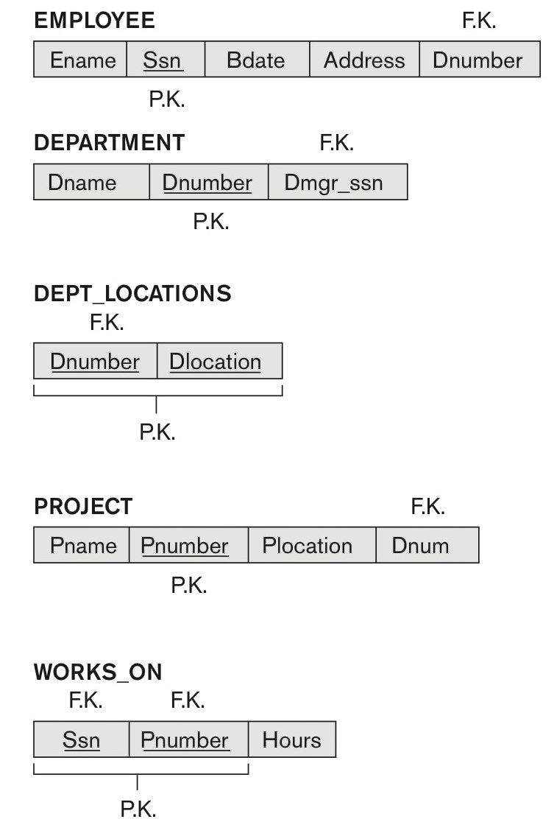
A simplified COMPANY relational database schema

Slide 11
Redundant Information in Tuples and Update Anomalies
Information is stored redundantly
Wastes storage
Causes problems with update anomalies
Insertion anomalies
Deletion anomalies
Modification anomalies

Slide 12
EXAMPLE OF AN UPDATE ANOMALY
Consider the relation:
EMP_PROJ(Emp#, Proj#, Ename, Pname, No_hours)
Update Anomaly:
If one copy of such repeated data is updated, an inconsistency is created unless all copies are similarly updated.
e.g., Changing the name of project number P1 from “Billing” to “Customer-Accounting” may cause this update to be made for all 100 employees working on project P1.

Slide 13
EXAMPLE OF AN INSERT ANOMALY
It may not be possible to store certain information unless some other, unrelated, information is stored as well.
Consider the relation:
EMP_PROJ(Emp#, Proj#, Ename, Pname, No_hours)
Insert Anomaly:
Cannot insert a project unless an employee is assigned to it.
Conversely
Cannot insert an employee unless an he/she is assigned to a project.

Slide 14
EXAMPLE OF A DELETE ANOMALY
It may not be possible to delete certain information without losing some other, unrelated, information as well.`
Consider the relation:
EMP_PROJ(Emp#, Proj#, Ename, Pname, No_hours)
Delete Anomaly:
When a project is deleted, it will result in deleting all the employees who work on that project.
Alternately, if an employee is the sole employee on a project, deleting that employee would result in deleting the corresponding project.

Slide 15
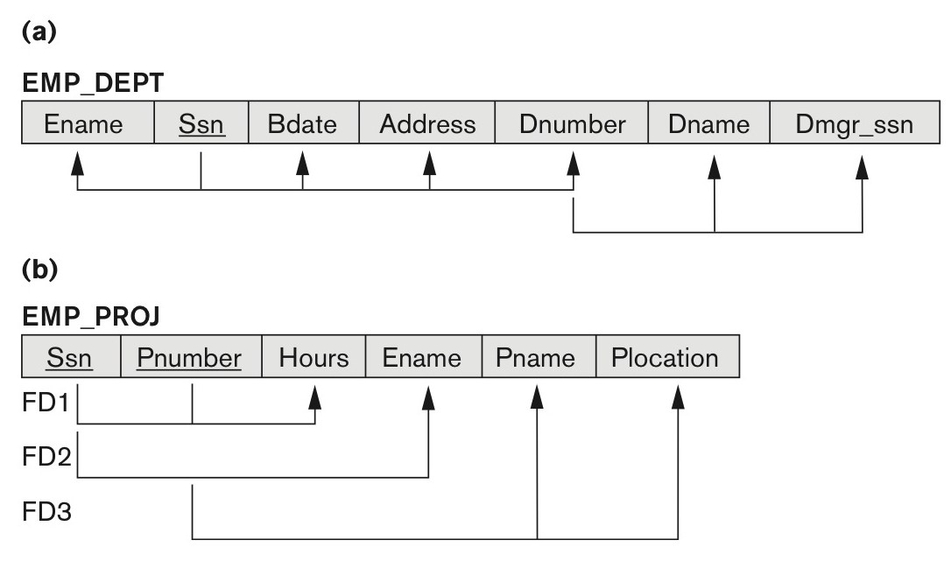
Two relation schemas suffering from update anomalies

Slide 16
What is NATURAL JOIN
We will cover it in detail in the coming lectures.
ID | Name | Dep
ATR/8932/10 | Yonas Fiseha | EE
ATR/9127/10 | Leul Mengistu | CE
ATR/0382/10 | Natnael Getachew | ME
ATR/5845/10 | Samuel Teshome | CE
ATR/8157/10 | Nahom Sileshi | EE
DepID | DepName
CE | Civil Engineering
EE | Electrical Engineering
ME | Mechanical Engineering
Join
ID | Name | DepID | DepName
ATR/8932/10 | Yonas Fiseha | EE | Electrical Engineering
ATR/9127/10 | Leul Mengistu | CE | Civil Engineering
ATR/0382/10 | Natnael Getachew | ME | Mechanical Engineering
ATR/5845/10 | Samuel Teshome | CE | Civil Engineering
ATR/8157/10 | Nahom Sileshi | EE | Electrical Engineering

Slide 17
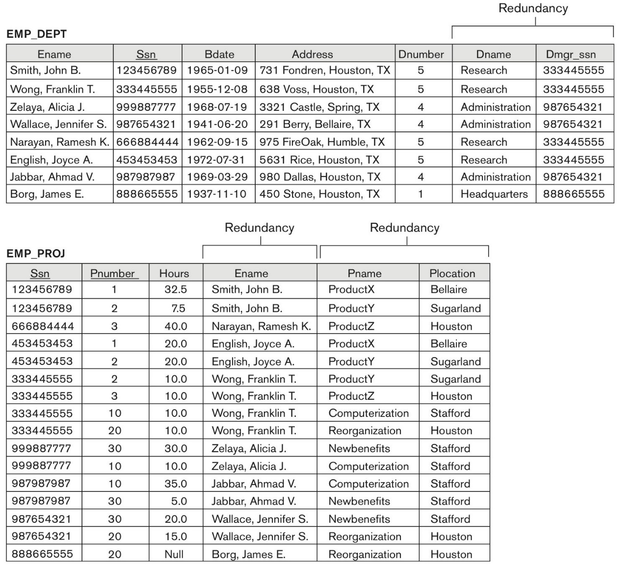
Sample states for EMP_DEPT and EMP_PROJ
EMP_DEPT and EMP_PROJ
Sample states: as a result of
applying NATURAL JOIN.
These may be stored as base relations.
Why?
For performance reasons.

Slide 18
Guideline for Redundant Information in Tuples and Update Anomalies
GUIDELINE 2:
Design a schema that does not suffer from the insertion, deletion and update anomalies.
If there are any anomalies present, then note them so that applications can be made to take them into account.

Slide 19
1.3 Null Values in Tuples
GUIDELINE 3:
Relations should be designed such that their tuples will have as few NULL values as possible
Attributes that are NULL frequently could be placed in separate relations (with the primary key)
Reasons for nulls:
Attribute not applicable or invalid
Attribute value unknown (may exist)
Value known to exist, but unavailable

Slide 20
Generation of Spurious Tuples – avoid at any cost
Bad designs for a relational database may result in erroneous results for certain JOIN operations
The "lossless join" property is used to guarantee meaningful results for join operations

Slide 21
Spurious Tuples (1)
GUIDELINE 4:
The relations should be designed to satisfy the lossless join condition.
No spurious tuples should be generated by doing a natural-join of any relations.
There are two important properties of decompositions:
Non-additive or losslessness of the corresponding join
Preservation of the functional dependencies.

Slide 22
Spurious Tuples (2)
There are two important properties of decompositions:
Non-additive or losslessness of the corresponding join
Preservation of the functional dependencies.
Note that:
Property (a) is extremely important and cannot be sacrificed. Guarantees that the spurious tuple generation problem does not occur with respect to the relation schemas created after decomposition
Property (b) is less stringent and may be sacrificed. (See Chapter 15).

Slide 23
Example: Spurious Tuples
R₁
x
R₂
R
R₁
R₂
A | B | B | C
1 | 1 | 1 | 1
1 | 1 | 1 | 2
1 | 1 | 2 | 1
1 | 1 | 3 | 2
2 | 1 | 1 | 1
2 | 1 | 1 | 2
2 | 1 | 2 | 1
2 | 1 | 3 | 2
3 | 2 | 1 | 1
3 | 2 | 1 | 2
3 | 2 | 2 | 1
3 | 2 | 3 | 2
4 | 3 | 1 | 1
4 | 3 | 1 | 2
4 | 3 | 2 | 1
4 | 3 | 3 | 2
A | B | C
1 | 1 | 1
2 | 1 | 2
3 | 2 | 1
4 | 3 | 2
A | B
1 | 1
2 | 1
3 | 2
4 | 3
B | C
1 | 1
1 | 2
2 | 1
3 | 2
Natural Join
R₁
R₂
A | B | B | C
1 | 1 | 1 | 1
1 | 1 | 1 | 2
2 | 1 | 1 | 1
2 | 1 | 1 | 2
3 | 2 | 2 | 1
4 | 3 | 3 | 2
Take only one attribute(B)
A | B | C
1 | 1 | 1
1 | 1 | 2
2 | 1 | 1
2 | 1 | 2
3 | 2 | 1
4 | 3 | 2
Are they equal?

Slide 24
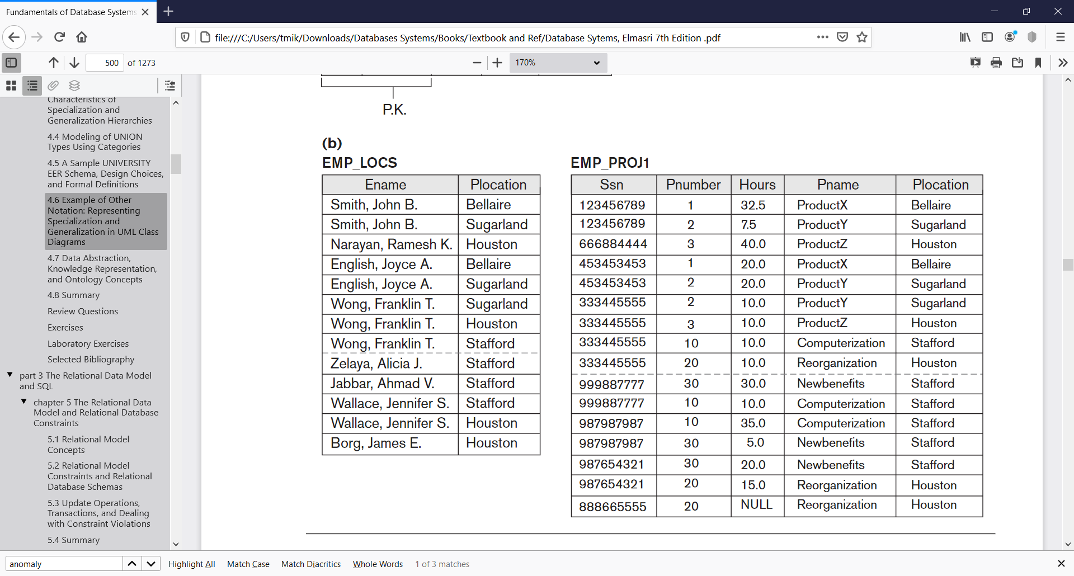
Spurious Tuples (3)
Let’s Join EMP_LOCS with EMP_PROJ1

Slide 25
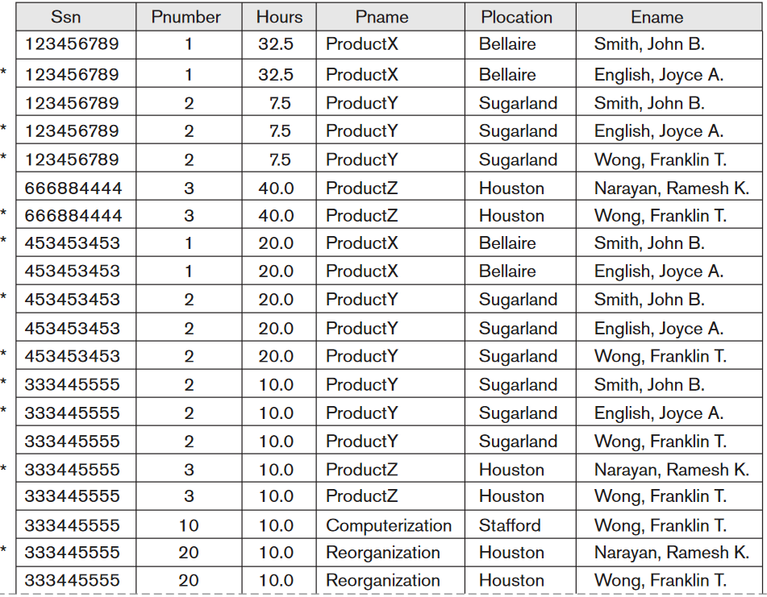
Spurious Tuples (4)

Slide 26
Spurious Tuples (5)
When we JOIN EMP_LOCS and EMP_PROJ1 using NATURAL JOIN, we do not get the correct original information.
This is because in this case Plocation happens to be the attribute that relates EMP_LOCS and EMP_PROJ1, and Plocation is neither a primary key nor a foreign key in either EMP_LOCS or EMP_PROJ1.
Design relation schemas so that they can be joined with equality conditions on attributes that are appropriately related (primary key, foreign key) pairs in a way that guarantees that no spurious tuples are generated.

Slide 27
Summary of Design Guidelines
GUIDELINE 1: Informally, each tuple in a relation should represent one entity or relationship instance.
GUIDELINE 2: Design a schema that does not suffer from the insertion, deletion and update anomalies.
GUIDELINE 3: Relations should be designed such that their tuples will have as few NULL values as possible
GUIDELINE 4: The relations should be designed to satisfy the lossless join condition.
Notes:
1.
2. If there are any anomalies present, then note them so that applications can be made to take them into account
3. Attributes that are NULL frequently could be placed in separate relations (with the primary key)
4. No spurious tuples should be generated by doing a natural-join of any relations.

Slide 28
Summary and Discussion of Design Guidelines
The problems we pointed out, which can be detected without additional tools of analysis, are as follows:
Anomalies that cause redundant work to be done during insertion into and modification of a relation, and that may cause accidental loss of information during a deletion from a relation
Waste of storage space due to NULLs and the difficulty of performing selections, aggregation operations, and joins due to NULL values
Generation of invalid and spurious data during joins on base relations with matched attributes that may not represent a proper (foreign key, primary key) relationship
Notes:
we informally discussed situations that lead to problematic relation schemas and we proposed informal guidelines for a good relational design.

Slide 29
Functional Dependencies

Slide 30
2. Functional Dependencies
So far we have dealt with the informal measures of database design.
We now introduce a formal tool for analysis of relational schemas that enables us to detect and describe some of the above-mentioned problems in precise terms.
The single most important concept in relational schema design theory is that of a functional dependency.

Slide 31
2. Functional Dependencies
Functional dependencies (FDs)
Are constraints that are derived from the meaning and interrelationships of the data attributes
Keys are used to define normal forms for relations
Are used to specify formal measures of the "goodness" of relational designs
A set of attributes X functionally determines a set of attributes Y if the value of X determines a unique value for Y

Slide 32
2.1 Defining Functional Dependencies
X  Y holds if whenever two tuples have the same value for X, they must have the same value for Y
For any two tuples t₁ and t₂ in any relation instance r(R): If t₁[X] = t₂[X], then t₁[Y]=t₂[Y]
X  Y in R specifies a constraint on all relation instances r(R)
Written as X  Y; can be displayed graphically on a relation schema as in Figures. (denoted by the arrow: →).
FDs are derived from the real-world constraints on the attributes

Slide 33
Examples of FD constraints (1)
Social security number determines employee name
SSN  ENAME
Project number determines project name and location
PNUMBER  {PNAME, PLOCATION}
Employee SSN and project number determines the hours per week that the employee works on the project
{SSN, PNUMBER}  HOURS

Slide 34
Examples of FD constraints (2)
An FD is a property of the attributes in the schema R
The constraint must hold on every relation instance r(R)
If K is a key of R, then K functionally determines all attributes in R
(since we never have two distinct tuples with t₁[K]=t₂[K])
Note:
A functional dependency is a property of the relation schema R, not of a particular legal relation state r of R. Therefore, an FD cannot be inferred automatically from a given relation extension r but must be defined explicitly by someone who knows the semantics of the attributes of R.
Notes:
A functional dependency is a property of the relation schema R, not of a particular legal relation state r of R. Therefore, an FD cannot be inferred automatically from a given relation extension r but must be defined explicitly by someone who knows the semantics of the attributes of R.

Slide 35
Defining FDs from instances
Note that in order to define the FDs, we need to understand the meaning of the attributes involved and the relationship between them.
An FD is a property of the attributes in the schema R
Given the instance (population) of a relation, all we can conclude is that an FD may exist between certain attributes.
What we can definitely conclude is – that certain FDs do not exist because there are tuples that show a violation of those dependencies.

Slide 36
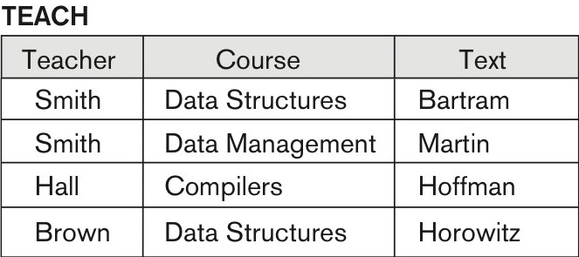
Ruling Out FDs
Note that given the state of the TEACH relation, we can say that:
The FDs
FD: Text → Course may exist.
However,
Teacher → Course, Teacher → Text and
Couse → Text are ruled out.

Slide 37
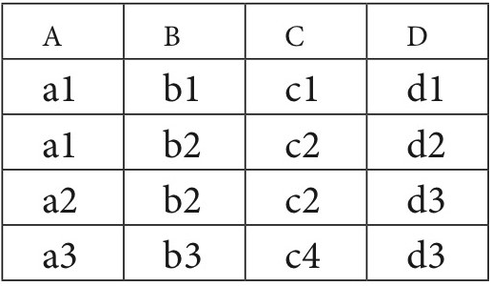
What FDs may exist?
A relation R(A, B, C, D) with its extension.
Which FDs may exist in this relation?

Slide 38
What FDs may exist?

Slide 39
What FDs may exist?
B → C

Slide 40
What FDs may exist?
The following FDs may hold
B → C, C → B, {A, B} → C, {A, B} → D, {C, D} → B

Slide 41
What FDs may exist?
The following FDs may hold
B → C
C → B
{A, B} → C
{A, B} → D
{C, D} → B
The following do not hold because: A → B (tuples 1 and 2 violate this constraint); B → A (tuples 2 and 3 violate this constraint); D → C (tuples 3 and 4 violate it).

Slide 42
Diagrammatic Notation for Displaying FDs
Q. List all FDs of the diagram shown above.

Slide 43
Functional Dependencies : Inference Rules, Equivalence and Minimal Cover
We discussed functional dependencies in previous slides.
To recollect:
A set of attributes X functionally determines a set of attributes Y if the value of X determines a unique value for Y.
Our goal here is to determine the properties of functional dependencies and to find out the ways of manipulating them.

Slide 44
Defining Functional Dependencies
X → Y holds if whenever two tuples have the same value for X, they must have the same value for Y
For any two tuples t₁ and t₂ in any relation instance r(R): If t₁[X]=t₂[X], then t₁[Y]=t₂[Y]
X → Y in R specifies a constraint on all relation instances r(R)
Written as X → Y; can be displayed graphically on a relation schema(denoted by the arrow)
FDs are derived from the real-world constraints on the attributes

Slide 45
Inference Rules for FDs (1)
Definition:
An FD X → Y is inferred from or implied by a set of dependencies F specified on R if X → Y holds in every legal relation state r of R; that is, whenever r satisfies all the dependencies in F, X → Y also holds in r.
Given a set of FDs F, we can infer additional FDs that hold whenever the FDs in F hold

Slide 46
Inference Rules for FDs (2)
Armstrong's inference rules:
IR1. (Reflexive) If Y subset-of X, then X → Y
IR2. (Augmentation) If X → Y, then XZ → YZ
(Notation: XZ stands for X U Z)
IR3. (Transitive) If X → Y and Y → Z, then X → Z
IR1, IR2, IR3 form a sound and complete set of inference rules
holds in every relation state r of R that satisfies the dependencies in F
the complete set of all possible dependencies can be inferred from F.

Slide 47
Proof of IR1 (Reflexive Dependency)
Suppose that X ⊇ Y and that two tuples t₁ and t₂ exist in some relation instance r of R such that t₁ [X] = t₂ [X]. Then t₁[Y] = t₂[Y] because X ⊇ Y
Hence, X → Y must hold in r.

Slide 48
Proof of IR2 (Augmentation) by Contradiction
Assume that X → Y holds in a relation instance r of R but that XZ → YZ does not hold.
Then there must exist two tuples t₁ and t₂ in r such that
(1) t₁ [X] = t₂ [X],
(2) t₁ [Y] = t₂ [Y],
(3) t₁ [XZ] = t₂ [XZ], and
(4) t₁ [YZ] ≠ t₂ [YZ].
This is not possible because from (1) and (3) we deduce
(5) t₁ [Z] = t₂ [Z], and from (2) and (5) we deduce
(6) t₁ [YZ] = t₂ [YZ], contradicting (4).

Slide 49
Proof of IR3 (Transitive Dependency)
Assume that
(1) X → Y and
(2) Y → Z both hold in a relation r.
Then for any two tuples t₁ and t₂ in r such that t₁ [X] = t₂ [X],
we must have
(3) t₁ [Y] = t₂ [Y], from assumption (1); hence we must also have
(4) t₁ [Z] = t₂ [Z] from (3) and assumption (2); thus
X → Z must hold in r.

Slide 50
Inference Rules for FDs (3)
Some additional inference rules that are useful:
Decomposition: If X → YZ, then X → Y and X → Z
Union: If X → Y and X → Z, then X → YZ
Psuedotransitivity: If X → Y and WY → Z, then WX → Z
The last three inference rules, as well as any other inference rules, can be deduced from IR1, IR2, and IR3 (completeness property)

Slide 51
Closure
Closure of a set F of FDs is the set F⁺ of all FDs that can be inferred from F
Closure of a set of attributes X with respect to F is the set X⁺ of all attributes that are functionally determined by X
X⁺ can be calculated by repeatedly applying IR1, IR2, IR3 using the FDs in F

Slide 52
Algorithm to determine Closure
Algorithm: Determining X⁺, the Closure of X under F
Input: A set F of FDs on a relation schema R, and a set of attributes X, which is a subset of R.
X⁺ := X;
repeat
oldX⁺ := X⁺;
for each functional dependency Y → Z in F do
if X⁺ ⊇ Y then X⁺ := X⁺ ∪ Z;
until (X⁺ = oldX⁺);
Read Algorithm 15.1

Slide 53
Example of Closure (1)
CLASS (Classid, Course#, Instr_name, Credit_hrs, Text, Publisher, Classroom, Capacity).
Let F, the set of functional dependencies for the above relation include the following fds:
FD1: Classid → Course#, Instr_name, Credit_hrs, Text, Publisher, Classroom, Capacity;
FD2: Course# → Credit_hrs;
FD3: {Course#, Instr_name} → Text, Classroom;
FD4: Text → Publisher
FD5: Classroom → Capacity
These fds above represent the meaning of the individual attributes and the relationship among them and defines certain rules about the classes.
{Classid} ⁺ = {Classid , Course#, Instr_name, Credit_hrs, Text, Publisher, Classroom, Capacity } = CLASS
Notes:
For example, consider the following relation schema about classes held at a university in a given academic year.

Slide 54
Example of Closure (2)
FD2: Course# → Credit_hrs;
FD3: {Course#, Instr_name} → Text, Classroom;
FD4: Text → Publisher
FD5: Classroom → Capacity
The closures of attributes or sets of attributes for some example sets:
{Classid}⁺ = {Classid , Course#, Instr_name, Credit_hrs, Text, Publisher, Classroom, Capacity} = CLASS
{Course#} ⁺ = { Course#, Credit_hrs}
{Course#, Instr_name }⁺ = {Course#, Credit_hrs, Text, Publisher, Classroom, Capacity, Instr_name}
Note that each closure above has an interpretation that is revealing about the attribute(s) on the left-hand-side.
The closure of { Classid } ⁺ is the entire relation CLASS indicating that all attributes of the relation can be determined from Classid and hence it is a key.

Slide 55
Example of Closure (3)
Compute the closure of the following set F of functional dependencies for relation schema R = (A, B, C, D, E). A →BC, CD → E, B→ D, E→A
Starting with A → BC, we can conclude: A→ B and A→ C.
Since A→ B and B→ D, A→ D (decomposition, transitive)
Since A→ CD and CD→ E, A→ E (union, decomposition, transitive)
Since A→ A, we have (reflexive) A→ ABCDE (union)
Since E→ A, E→ ABCDE (transitive)
Since CD→ E, CD→ ABCDE (transitive)
Since B→ D and BC→ CD, BC→ ABCDE (augmentative, transitive)
Also, C→ C, D→ D, BD→ D, etc
The Candidate keys are
A, BC, CD, and E

Slide 56
Equivalence of Sets of FDs
Two sets of FDs F and G are equivalent if:
Every FD in F can be inferred from G, and
Every FD in G can be inferred from F
Hence, F and G are equivalent if F⁺ = G⁺
Definition (Covers):
F covers G if every FD in G can be inferred from F
(i.e., if G⁺ subset-of F⁺)
F and G are equivalent if F covers G and G covers F
There is an algorithm for checking equivalence of sets of FDs

Slide 57
Equivalence of Sets of FDs(2)
We can determine whether F covers E by calculating X+ with respect to F for each FD X → Y in E, and then checking whether this X+ includes the attributes in Y.
If this is the case for every FD in E, then F covers E. We determine whether E and F are equivalent by checking that E covers F and F covers E.
It is left to the reader as an exercise to show that the following two sets of FDs are equivalent.
F = {A → C, AC → D, E → AD, E → H} and
G = {A → CD, E → AH}

Slide 58
Equivalence of Sets of FDs
Test if the two sets of FDs are equivalent.
F : { A→ B, B →C, C→ A }
G : { A →BC, B→ A, C→ A }
F : { A→ B, B →C, C→ A }
G : { A →BC, B→ A, C→ A }
{A}⁺: {A, B, C}
{B}⁺: {B, A, C}
{C}⁺: {C, A, B}
{A}⁺: {A, B, C}
{B}⁺: {B, C, A}
{C}⁺: {C, A, B}
YES THEY ARE EQUIVALENT

Slide 59
Equivalence of Sets of FDs
Test if the two sets of FDs are equivalent.
F = { A → BC, A → D, CD → E }
G = { A → BCE, A → ABD, CD → E }
Does F cover G
Does G cover F
A → BCE
A → BC, A → D, CD → E
A → ABD
A → BC, A → D
CD → E
CD → E
A → BC
A → BCE
A → D
A → ABD
CD → E
CD → E

Slide 60
Equivalence of Sets of FDs
Test if the two sets of FDs are equivalent.
F = {A → C, AC → D, E → AD, E → H}
G = {A → CD, E → AH}
F:{A→ C, AC→ D, E→ AD, E→ H}
G: {A → CD, E → AH}
{A}⁺: {A, C, D}
{C}⁺: {C}
{D}⁺: {D}
{E}⁺: {E, A, D, H, C}
{H}⁺: {H}
{A}⁺: {A, C, D}
{C}⁺: {C}
{D}⁺: {D}
{E}⁺:{E, A, H, C, D}
{H}⁺:{H}

Slide 61
Finding Minimal Cover of F.D.s (1)
Just as we applied inference rules to expand on a set F of FDs to arrive at F+, its closure, it is possible to think in the opposite direction to see if we could shrink or reduce the set F to its minimal form so that the minimal set is still equivalent to the original set F.
AKA Canonical Cover or Irreducible set of FDs

Slide 62
Minimal Sets of FDs
Whenever a user performs an update on the relation, the database system must ensure that the update does not violate any functional dependencies
that is, all the functional dependencies in F must be satisfied in the new database state.
The system must roll back the update if it violates any functional dependencies in the set F.

Slide 63
Minimal Sets of FDs
We can reduce the effort spent in checking for violations by testing a simplified set of functional dependencies that has the same closure as the given set.
Any database that satisfies the simplified set of functional dependencies also satisfies the original set, and vice versa.
since the two sets have the same closure.
The simplified set is easier to test.

Slide 64
Minimal Sets of FDs
Removing an attribute from the left side of a functional dependency could make it a stronger constraint.
For example, if we have AB → C and remove B, we get the possibly stronger result A → C.
It may be stronger because A → C logically implies AB → C, but AB → C does not, on its own, logically imply A → C.
But, depending on what our set F of functional dependencies happens to be, we may be able to remove B from AB → C safely.
For example, suppose that the set F = {AB → C, A → D, D → C}. Then we can show that F logically implies A → C, making B extraneous in AB → C.

Slide 65
Minimal Sets of FDs
Removing an attribute from the right side of a functional dependency could make it a weaker constraint.
For example, if we have AB → CD and remove C, we get the possibly weaker result AB → D.
because using just AB → D, we can no longer infer AB → C.
But, depending on what our set F of functional dependencies happens to be, we may be able to remove C from AB → CD safely.
For example, suppose that F = {AB → CD, A → C}. Then we can show that even after replacing AB → CD by AB → D, we can still infer AB → C and thus AB → CD.

Slide 66
Concept of Extraneousness
Example
Extraneous FD,
A→C is an extraneous FD in the set {A→B, B→C, A→C}
Extraneous Attribute (on either side of an FD)
AB → C, A → C (B is extraneous in the first FD)
AB → CD, A → C (is any attribute extraneous?)

Slide 67
Finding Minimal Cover of F.D.s
Definition:
An attribute in a functional dependency is considered extraneous attribute if we can remove it without changing the closure of the set of dependencies.
Formally, given F, the set of functional dependencies and a functional dependency X → A in F , attribute Y is extraneous in X if Y is a subset of X, and F logically implies (F - (X → A) ∪ { (X – Y) → A } )
Notes:
Canonical cover or irreducible set of FDs

Slide 68
Minimal Sets of FDs
A set of FDs is minimal if it satisfies the following conditions:
Every dependency in F has a single attribute for its RHS.
We cannot remove any dependency from F and have a set of dependencies that is equivalent to F.
We cannot replace any dependency X → A in F with a dependency Y → A, where Y is a proper-subset-of X and still have a set of dependencies that is equivalent to F.

Slide 69
Canonical Cover Example
A → BC B → C A → B AB → C
A → B
B → C
A → BC B → C A → B AB → C
A → BC B → C A → B
A minimal basis does not always have the smallest number of FD's, e.g., which of the following two sets of FD's is a minimal basis?
{A → B, B → C} or {A → C}
Notes:
(C is extraneous in the first FD and A is extraneous in the last FD) minimal basis: {A → B, B → C} a minimal basis does not always have the smallest number of FD's, e.g., which of the following two sets of FD's is a minimal basis? {A → B, B → C} or {A → C} remember a minimal basis must be a basis first

Slide 70
Minimal Sets of FDs (4)
Algorithm: Finding a Minimal Cover F for a Set of Functional Dependencies E
Input: A set of functional dependencies E.
Set F:= E.
Replace each functional dependency X → {A₁, A₂, ..., A_{n}} in F by the n functional dependencies X → A₁, X → A₂, ..., X → A_{n}.
For each functional dependency X → A in F for each attribute B that is an element of X if { {F – {X → A} } ∪ { (X – {B} ) → A} } is equivalent to F then replace X → A with (X – {B} ) → A in F.
/* The above constitutes a removal of the extraneous attribute B from X */
For each remaining functional dependency X → A in F if {F – {X → A} } is equivalent to F, then remove X → A from F.
/* The above constitutes a removal of the redundant dependency X → A from F */
Read Algorithm 15.2.

Slide 71
Canonical cover might not be unique
E.G.
F = {A → BC, B → AC, and C → AB}
F = {A → BC, B → AC, and C → AB}
F = {A → BC, B → AC, and C → AB}
F′ = {A→ B, B→ AC, and C→ AB}
Now, B is not extraneous on the right side of A → B under F′ .
we find A and B are extraneous in the right side of C → AB, leading to two choices of canonical cover:
F_{C} = {A → B, B → C, C → A} F_{C} = {A → B, B → AC, C → B}.
F′ = {A→ C, B→ AC, and C→ AB}
Now, C is not extraneous on the right side of A → C under F′
This case is symmetrical to the previous case, leading to two more choices of canonical cover:
F_{C} = {A→ C, C → B, and B → A} F_{C} = {A→ C, B→ C, and C → AB}.
As an exercise, can you find one more canonical cover for F?
Notes:
If C is deleted, we get the set
F′ = {A → B, B → AC, and C → AB}.
Now, B is not extraneous on the right side of A → B under F′ .
If B is deleted, we get the set
{A → C, B → AC, and C → AB}.

Slide 72
Example: Find the minimum cover of E.
Let the given set of FDs be E : {B → A, D → A, AB → D}
Determine if AB → D has any redundant attribute on the left-hand side; that is, can it be replaced by B → D or A → D?
Since B → A, by augmenting with B on both sides, we have BB → AB, or B → AB (i). However, AB → D as given (ii).
Hence by the transitive rule, we get from (i) and (ii), B → D. Hence AB → D may be replaced by B → D.
We now have a set equivalent to original E , say E′ : {B → A, D → A, B → D}.
No further reduction is possible in step 2 since all FDs have a single attribute on the left-hand side.
In step 3 we look for a redundant FD in E′. By using the transitive rule on B → D and D → A, we derive B → A. Hence B → A is redundant in E’ and can be eliminated.
Hence the minimum cover of E is {B → D, D → A}.
Notes:
Rhs =1 attr so we have completed step 1 of the Algorithm and can proceed to step 2.

Slide 73
Example(2)
G: {A→BCDE, CD→E}
For CD→E, neither C nor D is extraneous on the left-hand side, since we cannot show that C→E or D→E from the given FDs. Hence we cannot replace it with either
we want to see if any FD is redundant. Since A→CD and CD→E, by transitive rule, we get A→E. Thus, A→E is redundant in G.
So we are left with the set F, equivalent to the original set G as: {A→B, A→C, A→D, CD→E}.
F is the minimum cover. As we pointed out in foot-note 6, we can combine the first three FDs using the union rule (IR5) and express the minimum cover as: Minimum cover of G, F: {A→BCD, CD→E}
Notes:
Here, the given FDs are NOT in the canonical form. So we first convert them.

Slide 74
Ex.(3)
F:{AB→C, C→AB, B→C, ABC→AC, A→C, AC→B}
F:{AB→C, C→A, C→B, B→C, ABC→A, ABC→C, A→C, AC→B}
F:{AB→C, C→A, C→B, B→C, ABC→A, ABC→C, A→C, AC→B}
F:{AB→C, C→A, C→B, B→C, A→C, AC→B}
F:{AB→C, C→A, C→B, B→C, A→C, AC→B}
F:{B→C, C→A, C→B, B→C, A→C, AC→B}
F:{B→C, C→A, C→B, B→C, A→C, A→B}
F:{C→A, C→B, B→C, A→C, A→B}
C⁺ excluding C→A {C,B}
F:{C→A, C→B, B→C, A→C, A→B}
C⁺ excluding C→B {A,B,C}
F:{C→A, B→C, A→C, A→B}
B⁺ excluding B→C {B}
F:{C→A, B→C, A→C, A→B}
A⁺ excluding A→C {A,B,C}
F:{C→A, B→C, A→B}
A⁺ excluding A→B {A}
F’:{C→A, B→C, A→B}

Slide 75
Ex.(3)
F:{AB→C, C→AB, B→C, ABC→AC, A→C, AC→B}
F:{AB→C, C→A, C→B, B→C, ABC→A, ABC→C, A→C, AC→B}
F:{AB→C, C→A, C→B, B→C, ABC→A, ABC→C, A→C, AC→B}
F:{AB→C, C→A, C→B, B→C, A→C, AC→B}
F:{AB→C, C→A, C→B, B→C, A→C, AC→B}
F:{B→C, C→A, C→B, B→C, A→C, AC→B}
F:{B→C, C→A, C→B, B→C, A→C, C→B}
F:{C→A, B→C, A→C, C→B}
Complete the remaining steps

Slide 76
Minimal Sets of FDs
Every set of FDs has an equivalent minimal set
There can be several equivalent minimal sets
There is no simple algorithm for computing a minimal set of FDs that is equivalent to a set F of FDs. The process of Algorithm 15.2 9 (text book) is used until no further reduction is possible.
To synthesize a set of relations, we assume that we start with a set of dependencies that is a minimal set
E.g., see algorithm 15.4 (text book)

Slide 77
Example (1)
Question
Show that there an be more than one canonical cover for a given set of functional dependencies, using the following set of dependencies: F: {X →YZ, Y → XZ, and Z →XY}
X →YZ
Since Y→XZ, X→ XZZ that is X→Z or
Since Z→XY, X→ YXY that is X→Y
Hence X →YZ can be minimized to either X→Z or X→Y
Complete the rest.

Slide 78
Example (2)
Consider the relation R(A, B, C, D)
Derive all FD's which follow from S = {AB → C, C → D, D → A}
look at all subsets of {A,B,C,D} and see which lead to new FD's
SINGLETONS
ALL PAIRS
ALL TRIPLES
{A}⁺ = {A}
{B}⁺ = {B}
{C}⁺ = {A,C,D}
{D}⁺ = {A,D}
new FD: C → A
{A,B}⁺ = {A,B,C,D}
{A,C}⁺ = {A,C,D}
{A,D}⁺ = {A,D}
{B,C}⁺ = {A,B,C,D}
{B,D}⁺ = {A,B,C,D}
{C,D}⁺ = {A,C,D}
new FD's: AB → D,
BC → A
BD → C
{A,B,C}⁺ = {A,B,C,D}
{A,B,D}⁺ = {A,B,C,D}
{A,C,D}⁺ = {A,C,D}
{B,C,D}⁺ = {A,B,C,D}
no new FD's?
The complete set of completely nontrivial FD's is {AB → C, C → D, D → A, C → A, AB → D, BC → A, BD → C}
Notes:
All subsets of size 4: no need to look at them
we need not have computed the closure of sets {ABC}, {ABD}, and {BCD}

Slide 79
Example(3): Attribute Closure and Candidate Key
R = {A, B, C, D, E}
F = { B →CD, D → E, B → A, E → C, AD →B }
Is B → E in F⁺ ?
B⁺ = B
B⁺ = BCD
B⁺ = BCDA
B⁺ = BCDAE … Yes! and B is a key for R too!
Is D a key for R?
D⁺ = D
D⁺ = DE
D⁺ = DEC
… Nope!
Is AD a key for R? AD⁺ = AD
AD⁺ = ABD and B is a key, so Yes!
Is AD a candidate key for R?
A⁺ = A, D+ = DEC
… A,D not keys, so Yes!
Is ADE a candidate key for R?
… No! AD is a key, so ADE is a superkey, but not a cand. key

Slide 80
FD Review
key: {ID, Advisor_ID}
FD's: {ID → name level favorite_advisor, Advisor_ID → advisor_office}
Name | ID | Level | Advisor_ID | Advisor_Office | Favourate_Advisor
Mark | 1 | Senior | 349 | AN151 | 350
Mark | 1 | ??? | 350 | MH134 | 350
Kathy | 2 | Senior | 146 | AN240 | 146
Kathy | 1 | Senior | 351 | AN130 | 146
Kathy | 1 | Senior | 352 | AN131 | 146
Kathy | 2 | Senior | 351 | AN130 | 146
David | 3 | Junior | 349 | AN151 | 349
???
???
???
???
???
???
???
???
???
???
???
???
???
???
`???' denotes redundant, i.e., can be inferred from other tuples

Slide 81
Exercise
Compute the canonical cover F_{C} of relation R(A, B, C, D, E) with FDs { A →BC, CD → E, B→ D, E→A}.
Use Armstrong's axioms to prove the soundness of the union rule( if X → Y and X → Z then X → YZ)
Use Armstrong's axioms to prove the soundness of the pseudotransitivity rule( if X → Y and WY → Z then WX → Z)
Show that there an be more than one canonical cover for a given set of functional dependencies, using the following set of dependencies: X →YZ, Y → XZ, and Z →XY

